Slide 1
LHC Accelerator Status and Plans
Eric Prebys, Fermilab
Director, US LHC Accelerator Research Program (LARP)

Slide 2
Outline
Overview of the LHC
Including some basic accelerator physics
Current status and near term strategy
Planning for the future

Slide 3

A Word about LARP
The US LHC Accelerator Research Program (LARP) coordinates US R&D related to the LHC accelerator and injector chain at Fermilab, Brookhaven, SLAC, and Berkeley (with a little at J-Lab and UT Austin)
LARP has contributed to the initial operation of the LHC, but much of the program is focused on future upgrades.
The program is currently funded at a level of about $12-13M/year, divided among:
Accelerator research
Magnet research
Programmatic activities, including support for personnel at CERN
NOT to be confused with this “LARP” (Live-Action Role Play), which has led to some interesting emails

Slide 4
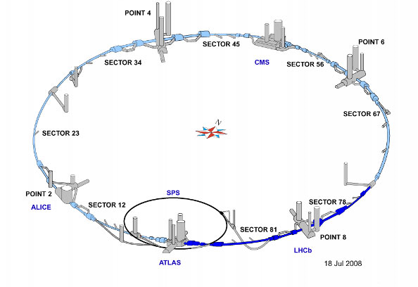
LHC Layout
8 crossing interaction points (IP’s)
Accelerator sectors labeled by which points they go between
ie, sector 3-4 goes from point 3 to point 4

Slide 5
Nominal LHC Parameters Compared to Tevatron
Parameter | Tevatron | “nominal” LHC
Circumference | 6.28 km (2*PI) | 27 km
Beam Energy | 980 GeV | 7 TeV
Number of bunches | 36 | 2808
Protons/bunch | 275x10⁹ | 115x10⁹
pBar/bunch | 80x10⁹ | -
Stored beam energy | 1.6 + .5 MJ | 366+366 MJ*
Peak luminosity | 4x10³² cm⁻²s⁻¹ | 1.0x10³⁴ cm⁻²s⁻¹
Main Dipoles | 780 | 1232
Bend Field | 4.2 T | 8.3 T
Main Quadrupoles | ~200 | ~600
Operating temperature | 4.2 K (liquid He) | 1.9K (superfluid He)
1.0x10³⁴ cm⁻²s⁻¹ ~ 50 fb⁻¹/yr
*2.1 MJ ≡ “stick of dynamite” ⇒ very scary numbers

Slide 6
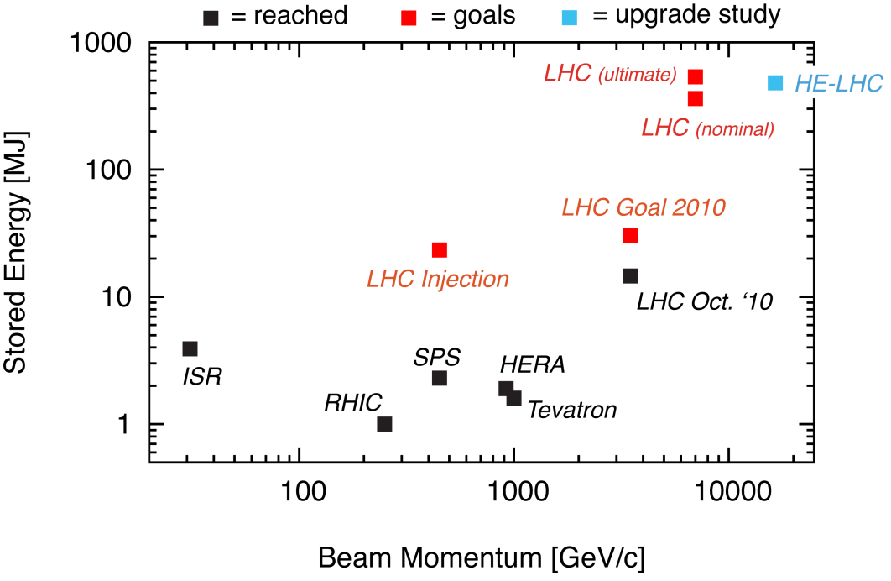
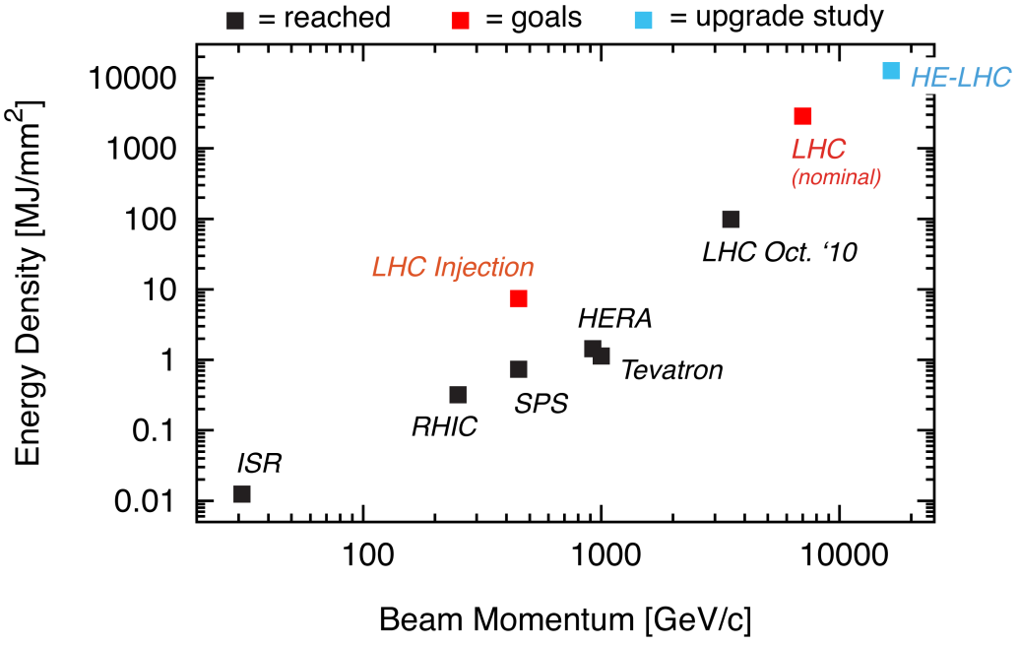
Stored Energy and Energy Density
LHC already
~1 order of magnitude beyond Tevatron in stored energy
~2 orders of magnitude beyond Tevatron in energy density
Machine protection dominates all aspects of LHC operation.

Slide 7
LHC (partial) timeline
1994:
The CERN Council formally approves the LHC
1995:
LHC Technical Design Report complete
2000:
LEP completes its final run
2002:
Magnet production fully transferred to industry
2005
Civil engineering complete (CMS cavern)
First dipole lowered into tunnel
2007
Last magnet delivered
All interconnections completed
2008
Accelerator complete
Last public access
Ring cold and under vacuum

Slide 8
Known problems before 2008 start up
De-training
All superconducting magnets were “trained” to > 7 TeV equivalent field prior to being installed on the tunnel.
Many dipoles from one of the three manufacturers “forgot” the training and exhibited quenches between 5 and 6 TeV
Symmetric quenches
To compensate for the inductive voltage, the original quench protection system compared the voltage drop across the two apertures in each magnet.
Insensitive to case where both apertures quench simultaneously, as often happens when a quench propagates from one magnet to the next.
For this reason, the decision was made to limit the initial running to 5 TeV, even before “the incident”.
Fixed by new quench protection system

Slide 9
Initial Startup and “The Incident”
On Sept. 10, 2008, the LHC first circulated beam (to great fanfare)
Everything was going remarkably smoothly, until Sept. 19th
Sector 3-4 was being ramped to 9.3 kA, the equivalent of 5.5 TeV
All other sectors had already been ramped to this level
Sector 3-4 had previously only been ramped to 7 kA (4.1 TeV)
A quench developed in the splice between a dipole and the neighboring quadrupole
Not initially detected by quench protection circuit
Within the first second, an arc formed at the site of the quench
The heat of the arc caused Helium to boil.
The pressure rose beyond .13 MPa and ruptured into the insulation vacuum.
Vacuum also lost in the beam pipe
The pressure at the subsector vacuum barrier reached ~10 bar
design value: 1.5 bar
This force was transferred to the magnet stands, which broke.
Damaged 42 dipoles and 15 quadrupoles
Badly contaminated beam pipe

Slide 10
Important Questions About The Incident
Why did the joint fail?
Inherent problems with joint design
No clamps
Details of joint design
Solder used
Quality control problems
Why wasn’t it detected in time?
There was indirect (calorimetric) evidence of an ohmic heat loss, but these data were not routinely monitored
The bus quench protection circuit had a threshold of 1V, a factor of >1000 too high to detect the quench in time.
Why did it do so much damage?
The pressure relief system was designed around an MCI Helium release of 2 kg/s, a factor of ten below what occurred.

Slide 11
Improvements
Bad joints
Test for high resistance and look for signatures of heat loss in joints
Warm up to repair any with signs of problems (additional three sectors)
Quench protection
Old system sensitive to 1V
New system sensitive to .3 mV (factor >3000)
Also fixed “symmetric quench” problem
Pressure relief
Warm sectors (4 out of 8)
Install 200mm relief flanges
Enough capacity to handle even the maximum credible incident (MCI)
Cold sectors
Reconfigure service flanges as relief flanges
Reinforce floor mounts
Enough capacity to handle the incident that occurred, but not quite the MCI

Slide 12
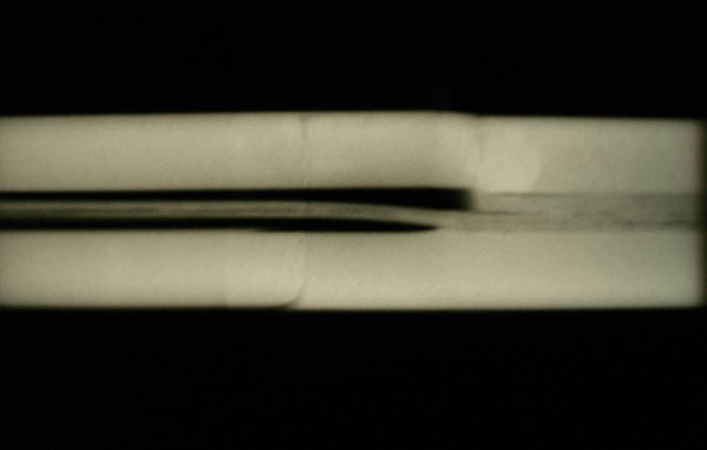
Remaining Problems
4/8 sectors still do not have new relief flanges
Ad hoc solution would handle what happened in 2008, but not maximum credible incident (MCI)
Systematic problem found with joints
Solder voids found near joints -> bad thermal contact
During a quench, integrity depends on integrity of Copper joint, which is hard to measure externally
For these reasons, it was decided
Limit initial running to 3.5+3.5 TeV
Run until 1 fb⁻¹, or the end of 2011
Shut down for ~15 months to repair all 10,000 joints
Re-solder
Clamp
Inspect
Following a quench, Copper must carry current as it ramps down

Slide 13
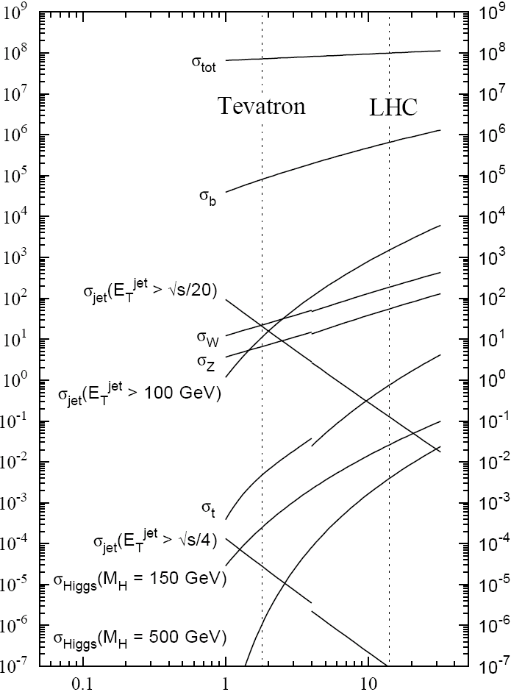
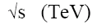
Experimental reach of LHC vs. Tevatron
1 fb⁻¹ at 3.5+3.5 TeV
~ Tevatron data set
σ_{W} (M_{W}=80 GeV)
σ_{Z} (M_{Z}=91 GeV)

Slide 14
Progress Since Start-up
Friday, November 20th, 2009
Beams circulated again (absolutely no fanfare this time)
Sunday, November 29th, 2009:
Both beams accelerated to 1.18 TeV simultaneously
LHC Highest Energy Accelerator
Monday, December 14th
Stable 2x2 at 1.18 TeV
Collisions in all four experiments
LHC Highest Energy Collider
Tuesday, March 30th, 2010
Collisions at 3.5+3.5 TeV
LHC Reaches target energy for 2010/2011
Then the hard part started…

Slide 15
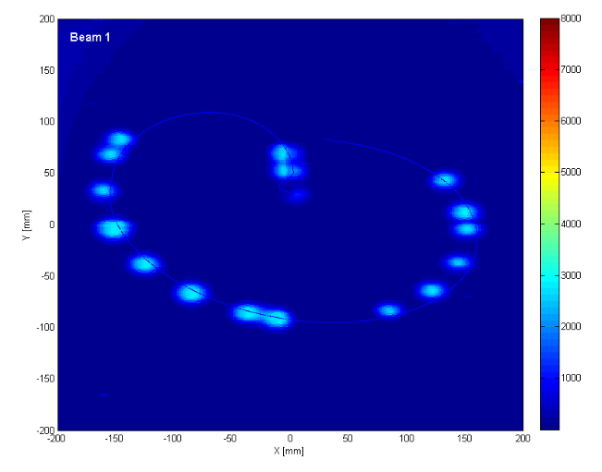
General Commissioning Plan
Push bunch intensity
Increase number of bunches
Go from single bunches to “bunch trains”, with gradually reduced spacing.
At all points, must carefully verify
Beam collimation
Beam protection
Beam abort
Remember:
TeV=1 week for cold repair
LHC=3 months for cold repair
Example: beam sweeping over abort

Slide 16
Digression: Making Luminosity
For identical, Gaussian colliding beams, luminosity is given by
Revolution frequency
Number of bunches
Bunch size
Transverse beam size
Geometric factor, related to crossing angle.
Betatron function at collision point
Normalized beam emittance
Recall:

Slide 17
Limits to LHC Luminosity*
Rearranging terms a bit…
Total beam current. Limited by:
Uncontrolled beam loss!
E-cloud and other instabilities
Brightness, limited by
Injector chain
Max. beam-beam
If n_{b}>156, must turn on crossing angle…
β at IP, limited by
magnet technology
chromatic effects
…which reduces this
*see, eg, F. Zimmermann, “CERN Upgrade Plans”, EPS-HEP 09, Krakow

Slide 18
Important features of the focal region
β
β distortion of off-momentum particles ∝ 1/β* (affects collimation)
s
⇒ small β* means large β (aperture) at focusing triplet

Slide 19
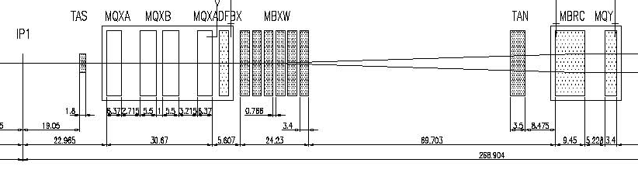
IR Layout and Crossing Angle
Present Separation Dipole
Final Triplet
IP
~59 m
Nominal Bunch spacing: 25 ns ⇒7.5 m
Collision spacing: 3.75 m
~2x15 parasitic collisions per IR
Effect depends on beam size
Negligible for nominal beam parameters
Very important for high luminosity upgrade.
Need Crossing Angle for n_{b}>156

Slide 20
Original Commissioning Plan
Getting 1 fb⁻¹ ⇒ peak luminosity of ~2x10³²
Planned to reach ~2/3 of nominal bunch intensity by 2011

Slide 21
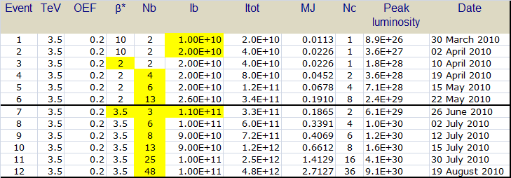
Some Happy Surprises
Happy surprise 1: Hit nominal bunch intensity in 3 months
Happy surprise 2: emittances lower than expected:
3.75 μm ⇒ 2.5 μm
Higher luminosities and larger effective apertures

Slide 22
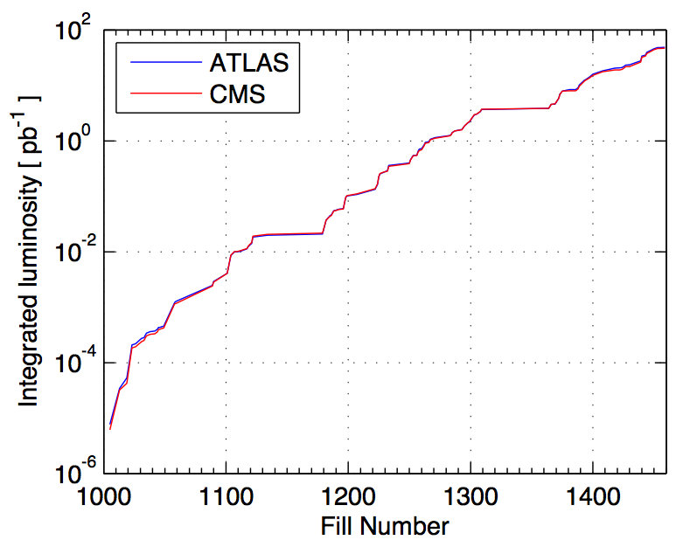
2010 Performance*
Performance ramp-up (368 bunches)
Nominal bunch operation (up to 48)
Bunch trains
Initial luminosity run
Nominal bunch commissioning
*From presentation by DG to CERN staff

Slide 23
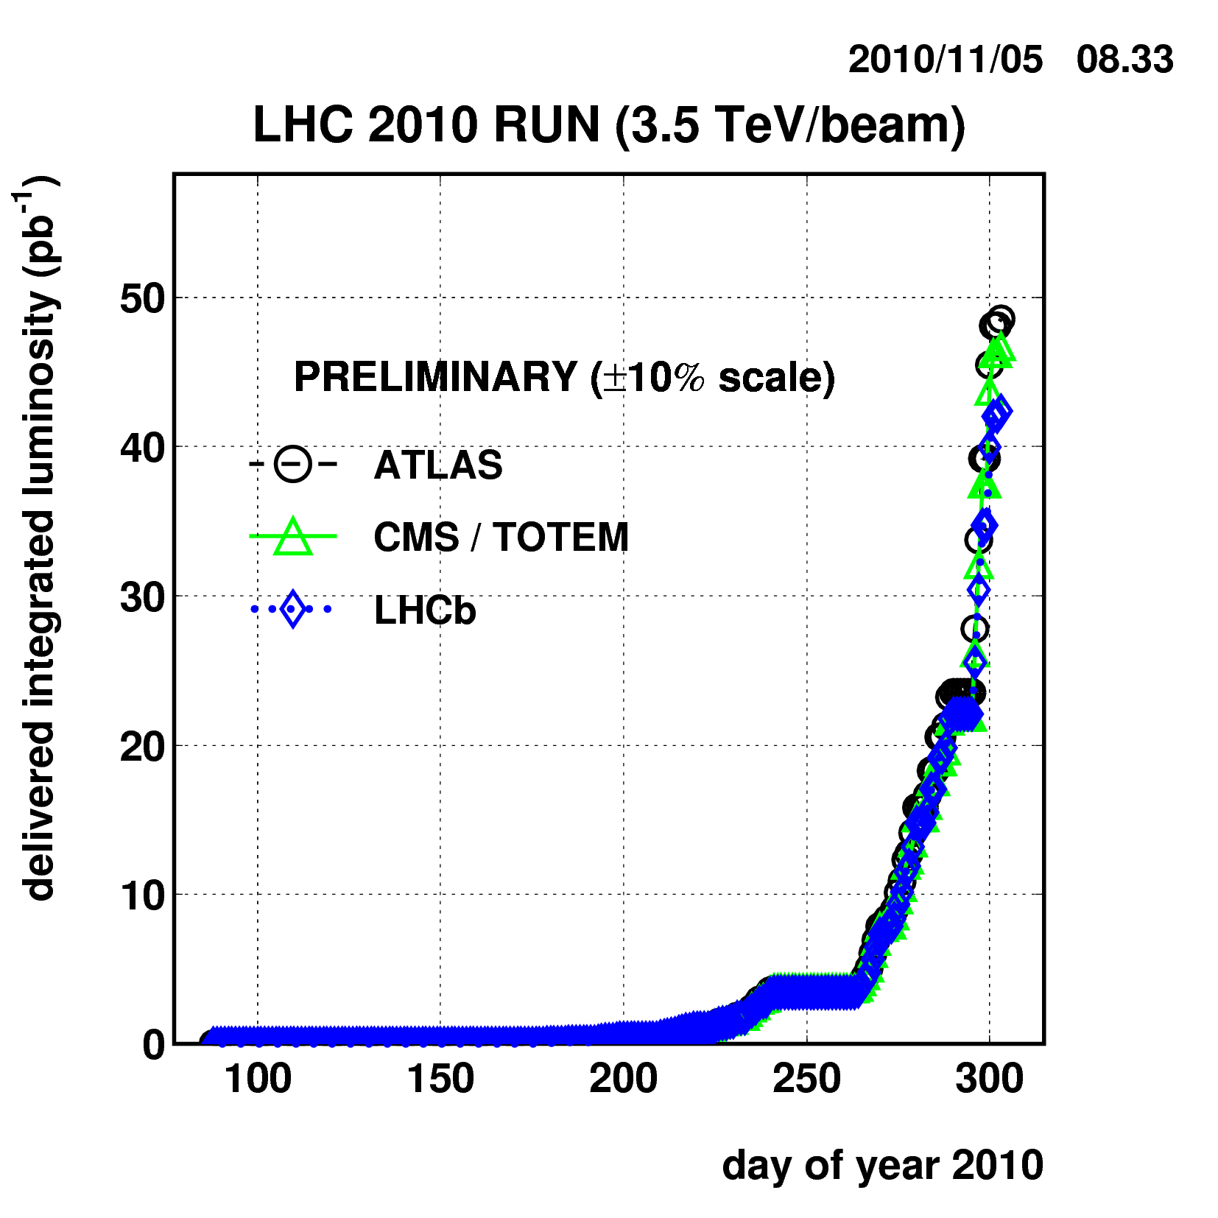
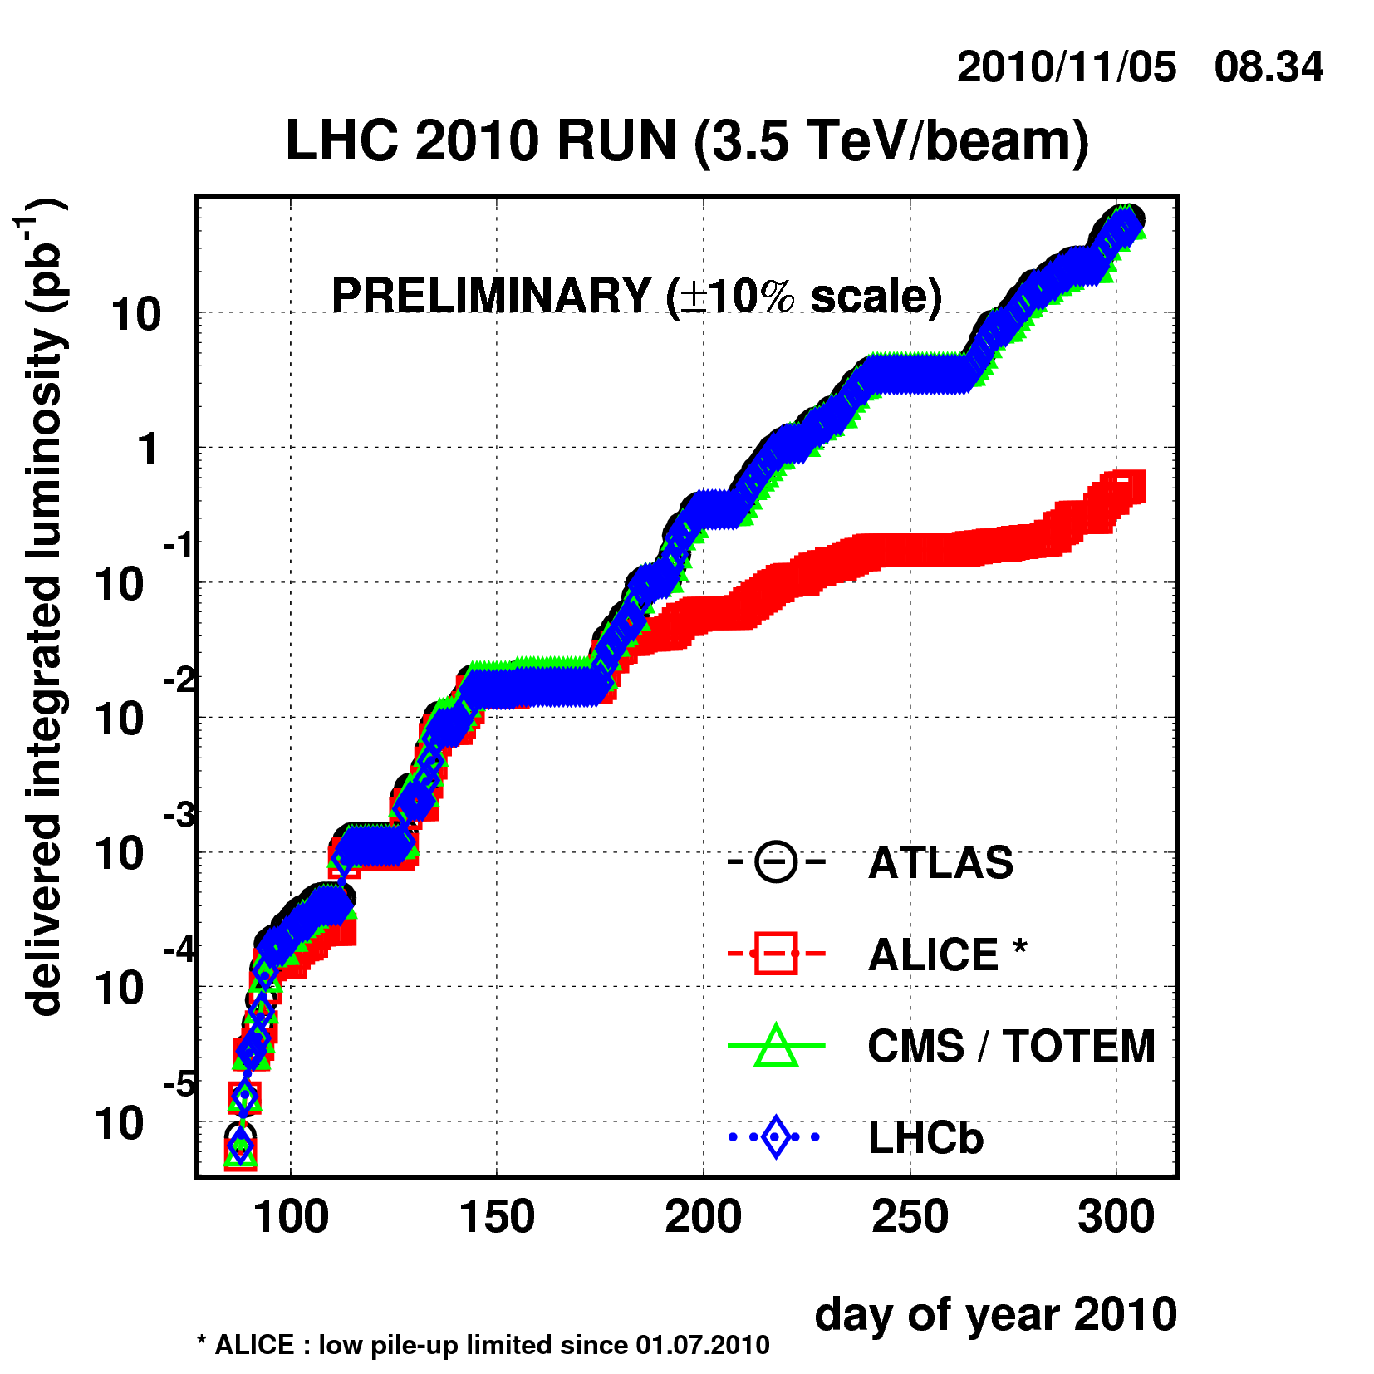
Current Status
Reached full bunch intensity
1.1x10¹¹/bunch
Can’t overstate how important this milestone is.
Peak luminosity: ~2x10³² cm⁻²s⁻¹
Enough to reach the 1 fb⁻¹ goal in 2011

Slide 24
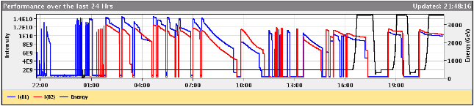
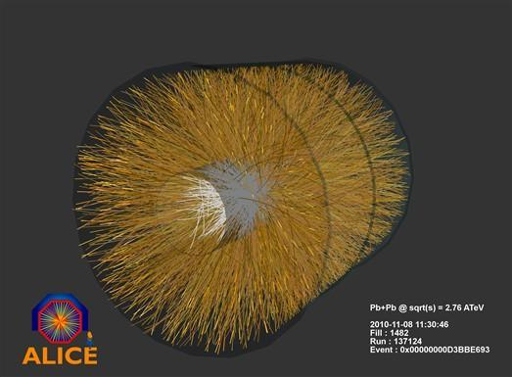
Transition to Ions
On Nov 4, the LHC began commissioning with ²⁰⁸Pb⁸²⁺
Beam circulating and accelerated within 24 hours
First collisions on Nov. 7
Beam1 : injection and capture
Beam2: injection and capture
Optics Checks, Beam Instrumentation & Collimation
First ramp, collimation at high energy and squeeze

Slide 25
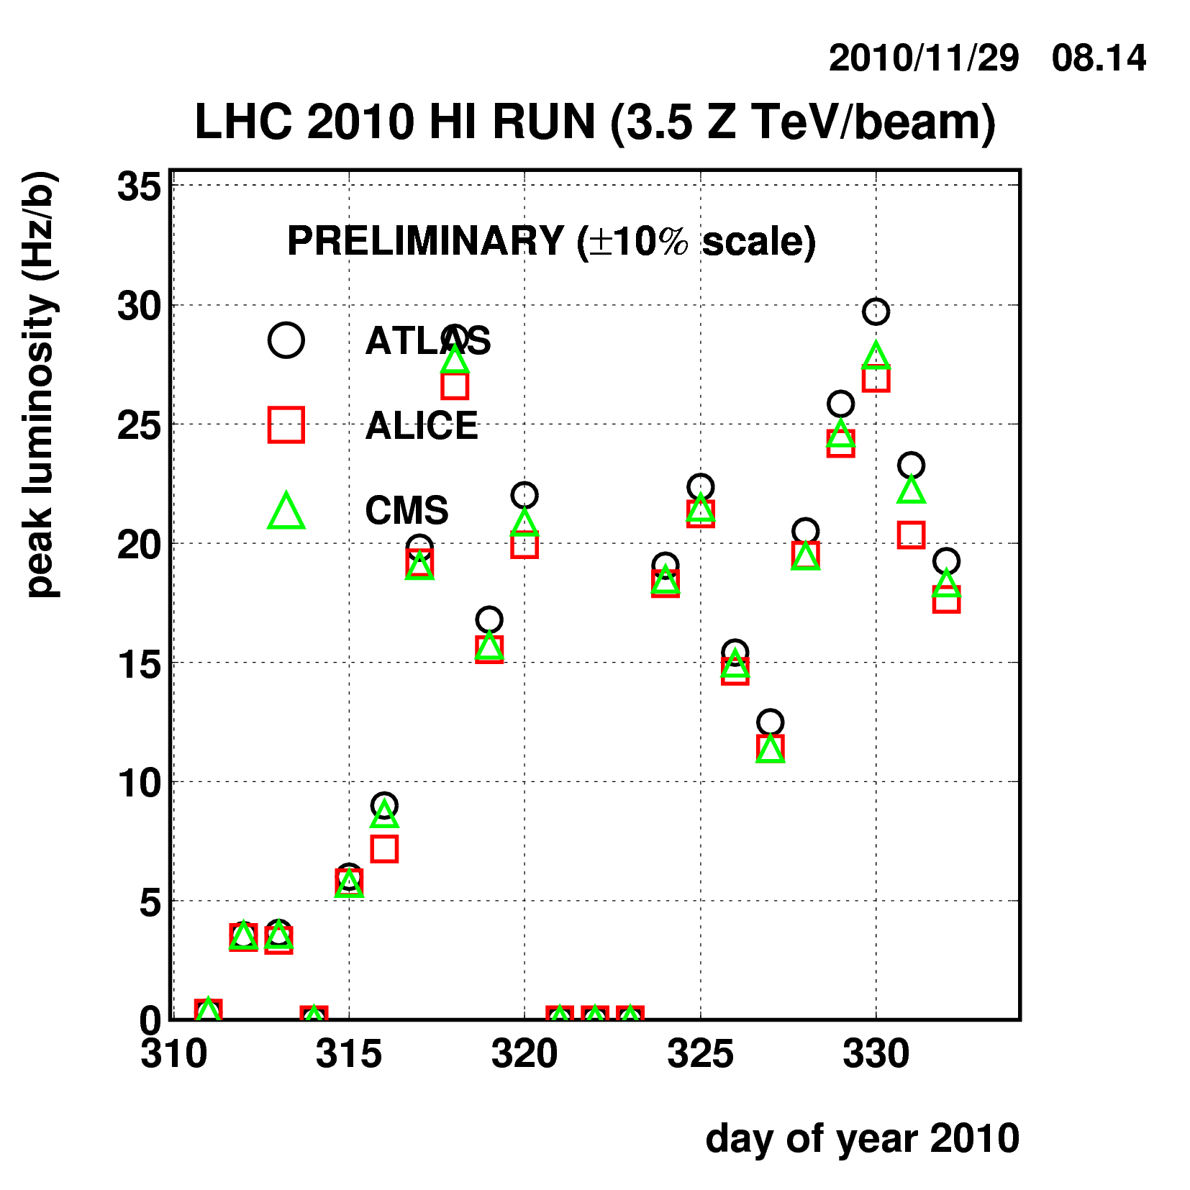
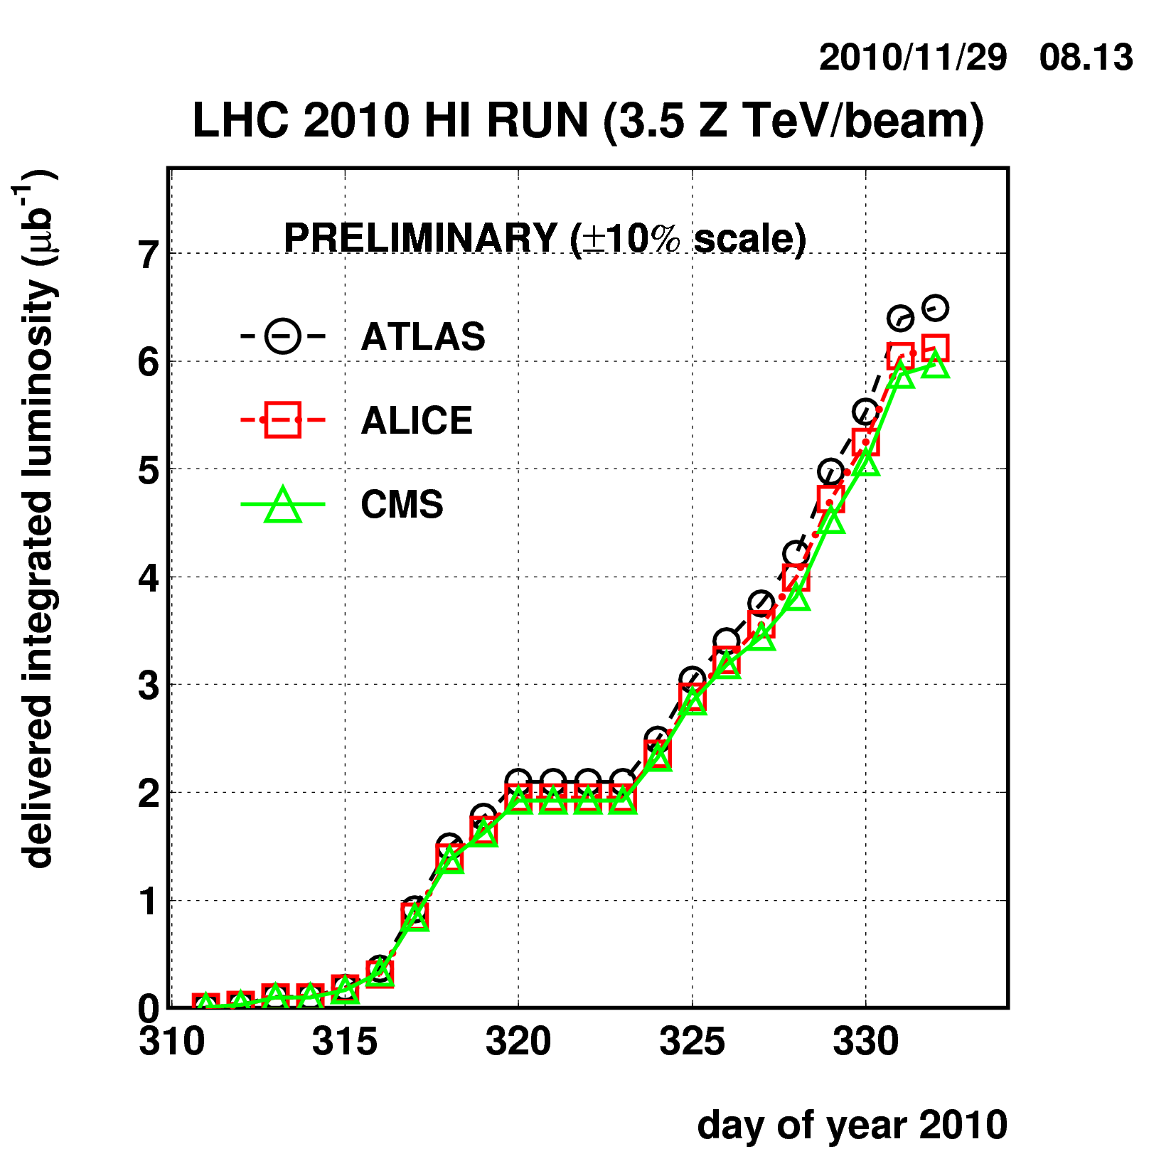
Heavy Ion Performance
Peak luminosity: 2.9x10²⁵ cm⁻²s⁻¹
Integrated: 6.4 μb

Slide 26
General plan for next few years
In 2011 (and 2012?)
Remain at nominal bunch intensity
Continue to increase number of bunches until collimation limit is achieved
Limit 5-10x10³² cm⁻²s⁻¹
Shutdown
Fix all joints
Add dispersion collimation around IR3
Will raise luminosity limit to .5-1x10³⁴ cm⁻²s⁻¹
2016 Shutdown
Complete collimation system
Reach (at least) nominal luminosity after that
Collimation limit >5x10³⁴ cm⁻²s⁻¹

Slide 27
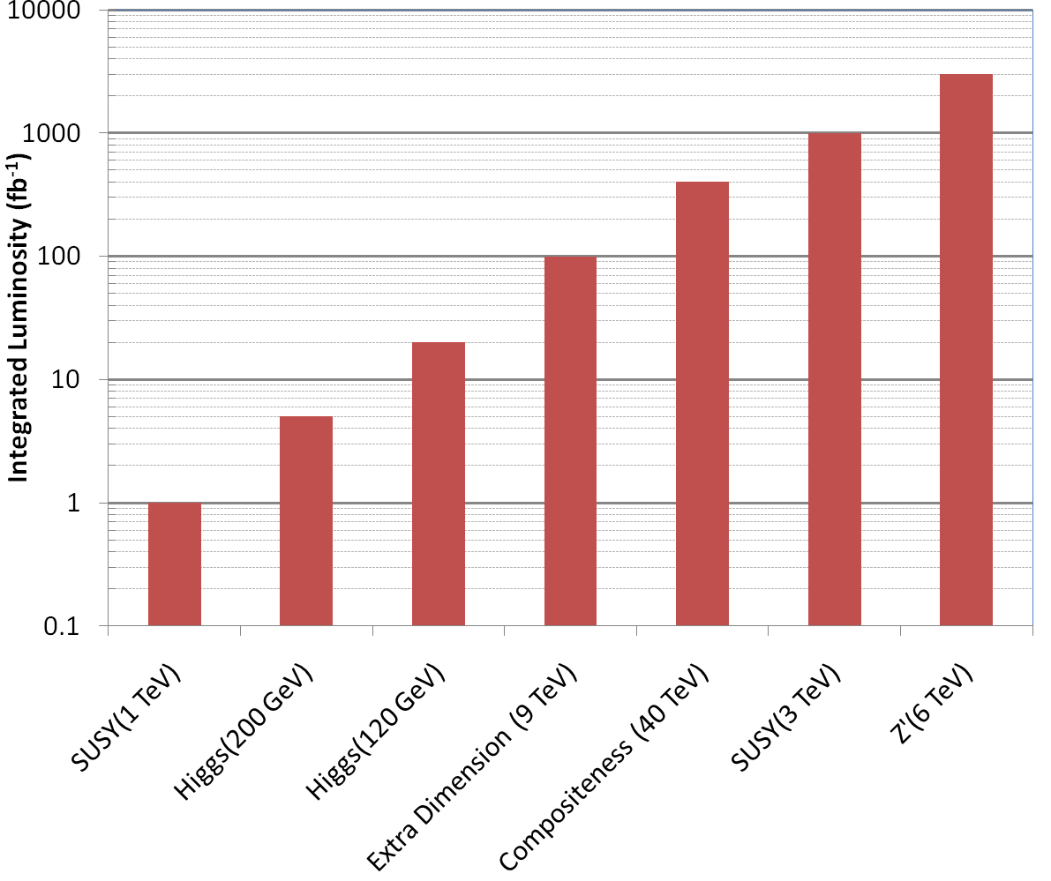
Nice work, but…
3000 fb⁻¹
~ 50 years at nominal luminosity!
The future begins now

Slide 28
Attacking Luminosity on Many Fronts
Total beam current:
Probably limited by electron cloud in SPS
Beam pipe coating?
Feedback system?
Beam size at interaction region
Limited by magnet technology in final focusing quads
Nb₃Sn?
Chromatic effects⇔collimation
Still being investigated
Beam brightness (N_{b}/ε)
Limited by injector chain
New LINAC
Increased Booster Energy
PS⇒PS2
Biggest uncertainty is how to deal with crossing angle…
unlikely

Slide 29
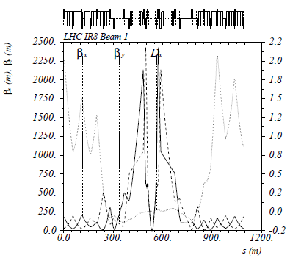
The Case for New Quadupoles
HL-LHC Proposal: β*=55 cm ⇒ β*=10 cm
Just like classical optics
Small, intense focus ⇒ big, powerful lens
Small β*⇒huge β at focusing quad
Need bigger quads to go to smaller β*
Existing quads
70 mm aperture
200 T/m gradient
Proposed for upgrade
At least 120 mm aperture
200 T/m gradient
Field 70% higher at pole face
⇒ Beyond the limit of NbTi

Slide 30
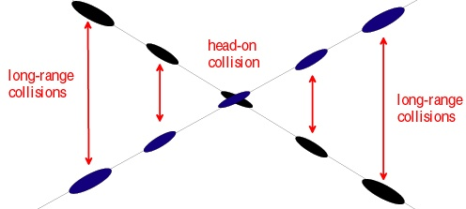
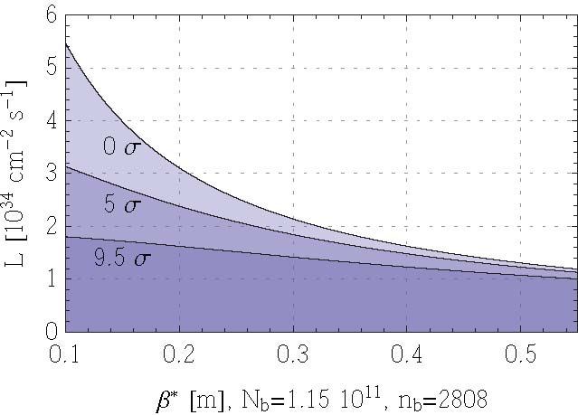
Effect of Crossing Angle
Reduces luminosity
“Piwinski Angle”
Separation of first parasitic interaction
No crossing angle
Effect increases for smaller beam
Nominal crossing angle (9.5σ)
Conclusion: without some sort of compensation, crossing angle effects will ~cancel any benefit of improved focus optics!
Limit of current optics
Upgrade plan

Slide 31
Summary of Options (Not Quite Up to date)
Requires magnets close to detectors
Requires (at least) PS2
Big pile-up
Parameter | Symbol | Initial | Full Luminosity Upgrade
 |  |  | Early Sep. | Full Crab | Low Emit. | Large Piw. Ang.
transverse emittance | ε [μm] | 3.75 | 3.75 | 3.75 | 1.0 | 3.75
protons per bunch | N_{b} [10¹¹] | 1.15 | 1.7 | 1.7 | 1.7 | 4.9
bunch spacing | Δt [ns] | 25 | 25 | 25 | 25 | 50
beam current | I [A] | 0.58 | 0.86 | 0.86 | 0.86 | 1.22
longitudinal profile |  | Gauss | Gauss | Gauss | Gauss | Flat
rms bunch length | σ_{z} [cm] | 7.55 | 7.55 | 7.55 | 7.55 | 11.8
beta* at IP1&5 | β∗ [m] | 0.55 | 0.08 | 0.08 | 0.1 | 0.25
full crossing angle | θ_{c} [μrad] | 285 | 0 | 0 | 311 | 381
Piwinski parameter | φ=θ_{c}σ_{z}/(2*σ_{x}*) | 0.64 | 0 | 0 | 3.2 | 2.0
peak luminosity | L [10³⁴ cm⁻²s⁻¹] | 1 | 14.0 | 14.0 | 16.3 | 11.9
peak events/crossing |  | 19 | 266 | 266 | 310 | 452
initial lumi lifetime | τ_{L} [h] | 22 | 2.2 | 2.2 | 2.0 | 4.0
Luminous region | σ_{l} [cm] | 4.5 | 5.3 | 5.3 | 1.6 | 4.2
excerpted from F. Zimmermann, “LHC Upgrades”, EPS-HEP 09, Krakow, July 2009

Slide 32
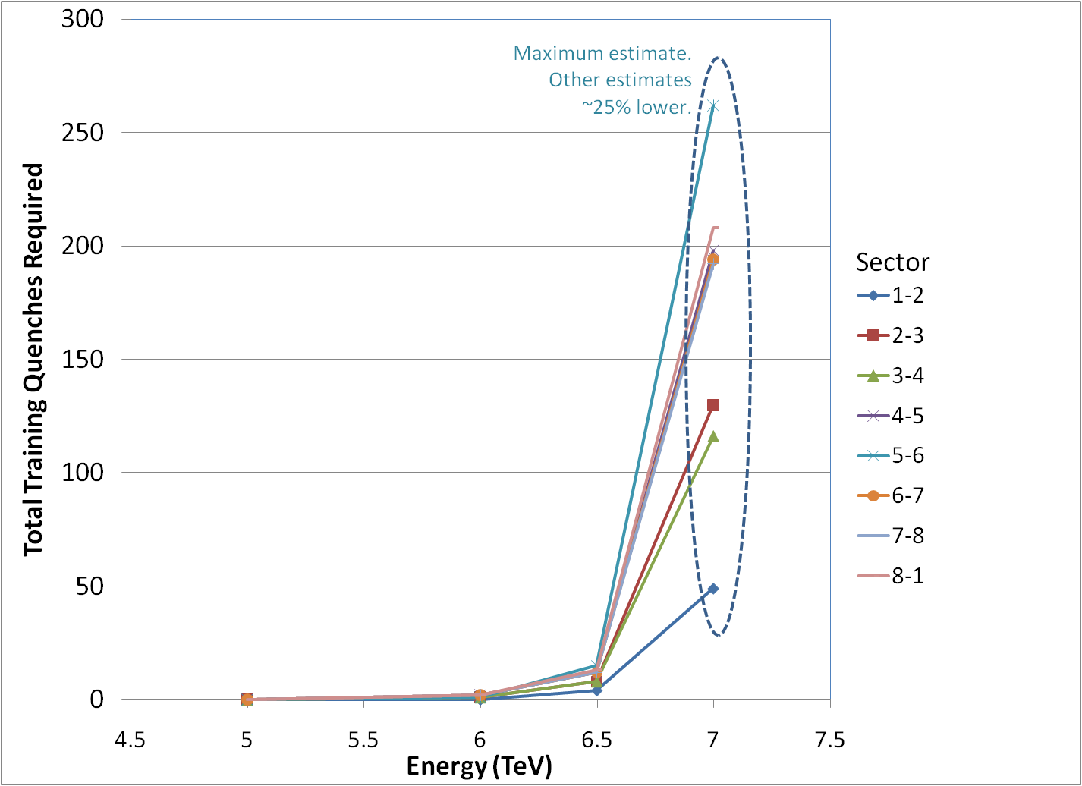
Getting to 7 TeV*
Note, at high field, max 2-3 quenches/day/sector
Sectors can be done in parallel/day/sector (can be done in parallel)
No decision yet, but it will be a while
*my summary of data from A. Verveij, talk at Chamonix, Jan. 2009

Slide 33
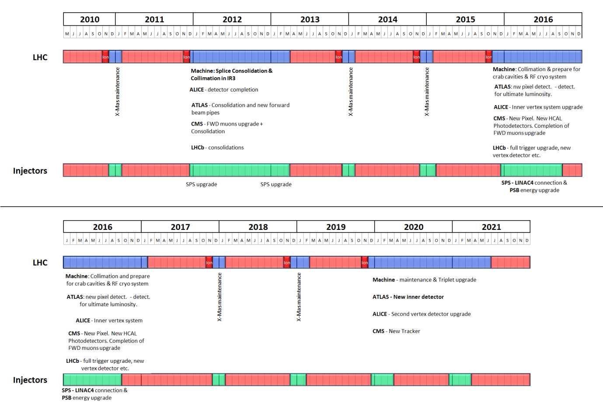
Tentative LHC Timeline
Energy: 3.5 TeV
Energy: 6-7 TeV
Collimation limit ~2-5x10³²
Collimation limit .5-1x10³⁴
Energy: ~7.0 TeV
Energy: ~7 TeV
Luminosity→1x10³⁴
Lum.→>5x10³⁴
Collimation limit >5x10³⁴

Slide 34
Major Questions at Chamonix
Run through 2012?
Luminosity will likely still be increasing
Increase Energy to 4?
Can get same Higgs reach with ~20% less luminosity
5σ discovery over entire allowed mass region with 10 fb⁻¹
Is it worth pursuing the HL-LHC upgrade?
Given the demonstrated performance of the LHC so far, it’s not unlikely that it could reach 2-3x10³⁴ cm⁻²-s⁻¹ in more or less it’s current configuration (once final collimation system is in place).
It’s unlikely the experiments can live with much more that 5x10³⁴.
???

Slide 35
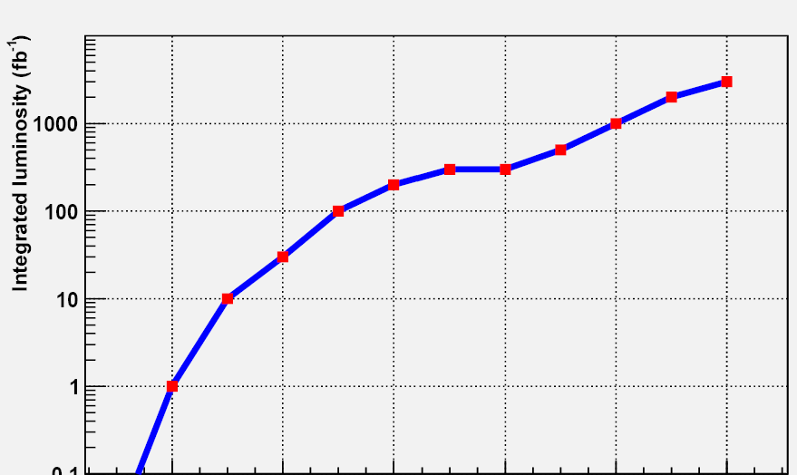
The Long Road to Discovery
Even with the higher luminosity, still need a lot of time to reach the discovery potential of the LHC
Lots of new challenges between now and then!
Z’@6TeV
ADD X-dim@9TeV
SUSY@3TeV
Note: VERY outdated plot. Ignore horizontal scale.
Could conceivably get to 3000 fb⁻¹ by 2030.
3000
Compositeness@40TeV
H(120GeV)→γγ
300
Higgs@200GeV
SUSY@1TeV
30
200 fb⁻¹/yr
HL-LHC Upgrade
10-20
fb⁻¹/yr
50-100 fb⁻¹/yr
500 fb⁻¹/yr
50 x Tevatron luminosity
250 x Tevatron luminosity

Slide 36
Acknowledgements and further reading
This talk represents the work of an almost countless number of people.
I have incorporated significant material from:
Oliver Bruening’s presentation at the last LARP collaboration meeting
http://tinyurl.com/cm15-bruening
Rolf Heuer’s recent talk to the General Meeting
http://tinyurl.com/heuer-jan-2011
To learn everything about everything about the LHC, see the material from the Chamonix conferences
http://tinyurl.com/Chamonix2009
http://tinyurl.com/Chamonix2010
http://tinyurl.com/Chamonix2011 (in progress)

Slide 37
Backup slides

Slide 38
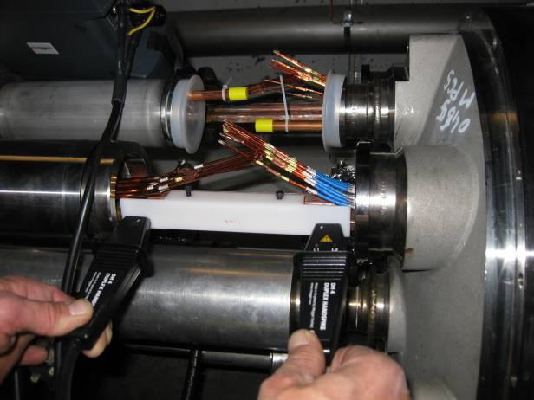
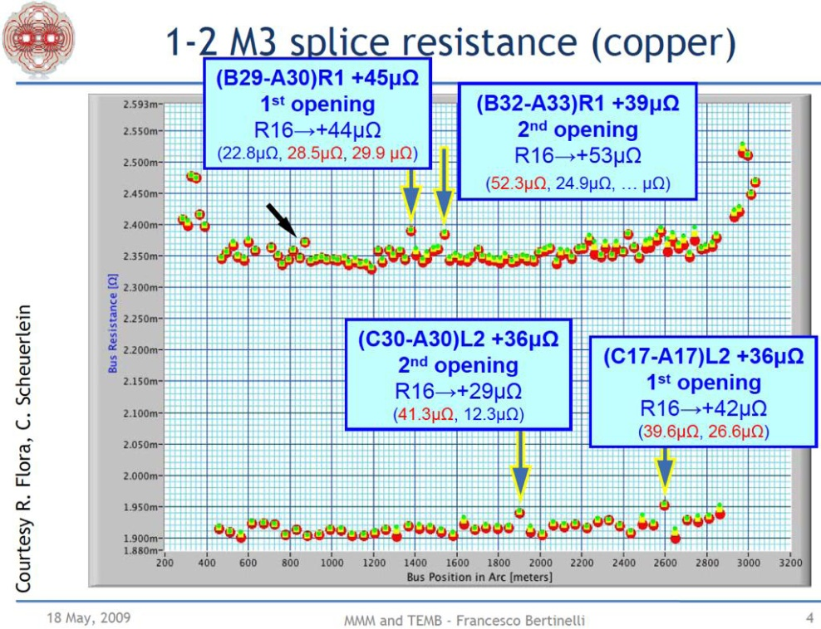
Machine wide investigations Q2 2009
Electrical measurements while warm on sectors 12 34 56 67
Confirms new problem with the copper stabilizers
Non-invasive electrical measurements to show suspicious regions
Several bad regions found
Open and make precise local electrical measurements
Several bad stabilizers found (30µΩ to 50µΩ) and fixed
Measured other 4 sectors at 80K (noisy but gives limits)

Slide 39
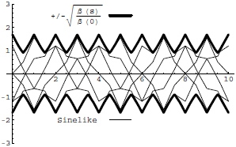
Digression: All the Beam Physics U Need 2 Know
Transverse beam size is given by
Betatron function: envelope determined by optics of machine
Trajectories over multiple turns
Note: emittance shrinks with increasing beam energy ⇒”normalized emittance”
Emittance: area of the ensemble of particle in phase space
Area = ε
Usual relativistic β & γ

Slide 40
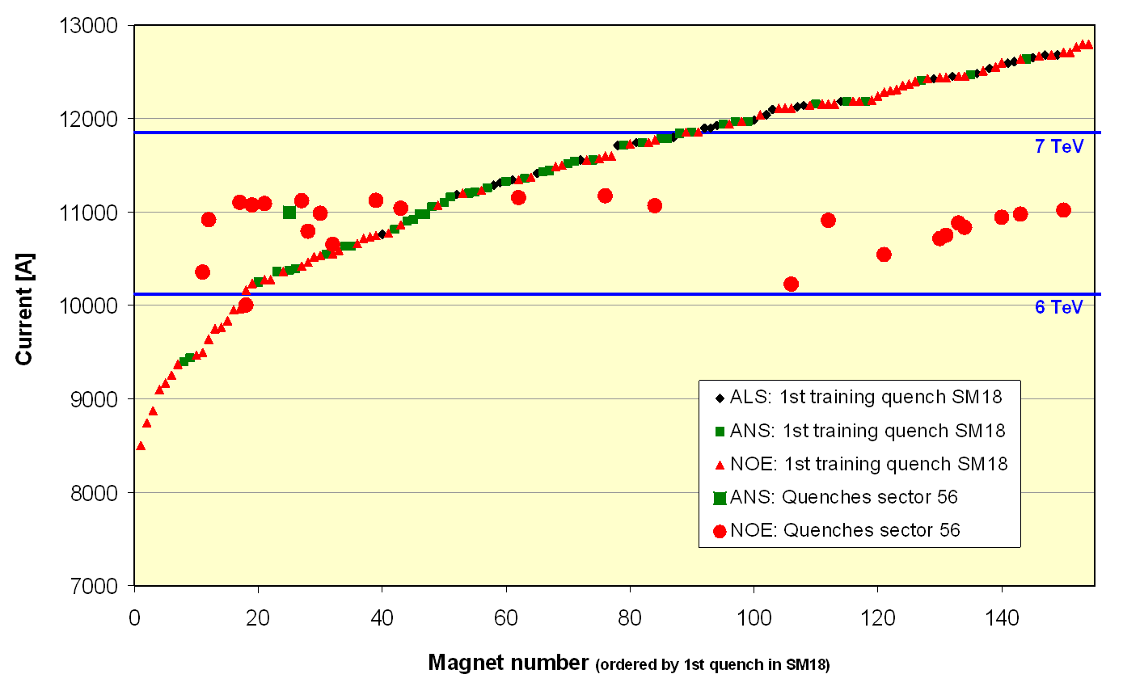
Problems Discovered Prior to 2008 Start
1st Training quench above ground
Magnet de-training
ALL magnets were trained to achieve 7+ TeV after a thermal cycle.
After being installed in the tunnel, it was discovered that the magnets supplied by one of the three vendors “forgot” their training, and would need to be retrained to reach 7 TeV.
Symmetric Quenches
The original LHC quench protection system subtracted the inductive voltage drop by taking the difference between the voltage drop across the two apertures.
It was discovered in tests that when quenches propagate from one dipole to the next, they often do so symmetrically, rendering the system dangerously insensitive at high current.
1st quench in tunnel
For these reasons, the initial energy target was reduced to 5+5 TeV well before the start of the 2008 run.

Slide 41
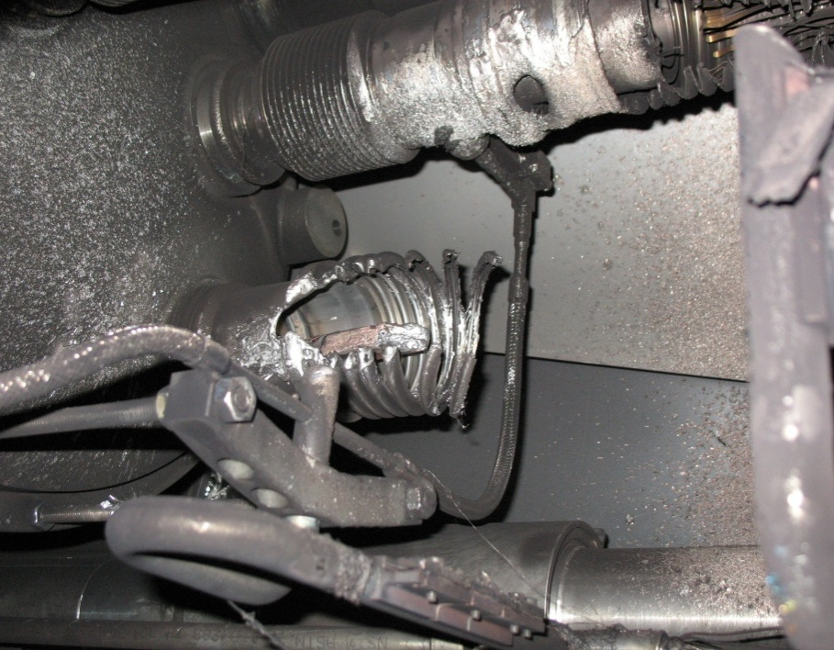
What happened?
Theory: A resistive joint of about 220 nΩ with bad electrical and thermal contacts with the stabilizer
No electrical contact between wedge and U-profile with the bus on at least 1 side of the joint
No bonding at joint with the U-profile and the wedge
Loss of clamping pressure on the joint, and between joint and stabilizer
Degradation of transverse contact between superconducting cable and stabilizer
Interruption of longitudinal electrical continuity in stabilizer
Problem: this is where the evidence used to be
A. Verweij

Slide 42
Improved quench protection*
Old quench protection circuit triggered at 1V on bus.
New QPS triggers at .3 mV
Factor of 3000
Should be sensitive down to 25 nOhms (thermal runaway at 7 TeV)
Can measure resistances to <1 nOhm
Concurrently installing improved quench protection for “symmetric quenches”
A problem found before September 19th
Worrisome at >4 TeV
*See talks by Arjan Verveij and Reiner Denz, Chamonix 2009

Slide 43
Improved pressure relief*
New configuration on four cold sectors: Turn several existing flanges into pressure reliefs (while cold). Also reinforce stands to hold ~3 bar
New configuration on four
warm sectors: new flanges
(12 200mm relief flanges)
(DP: Design Pressure)
L. Tavian
*Vittorio Parma and Ofelia Capatina, Chamonix 2009

Slide 44
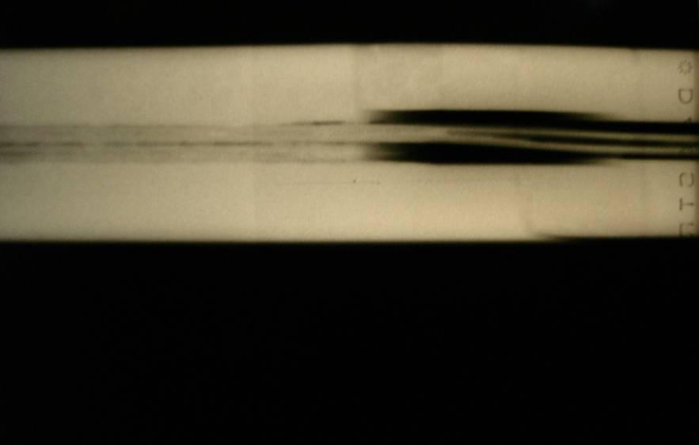
Bad surprise
With new quench protection, it was determined that joints would only fail if they had bad thermal and bad electrical contact, and how likely is that?
Very, unfortunately ⇒ must verify copper joint
Have to warm up to at least 80K to measure Copper integrity.
Solder used to solder joint had the same melting temperature as solder used to pot cable in stablizer
⇒Solder wicked away from cable

Slide 45
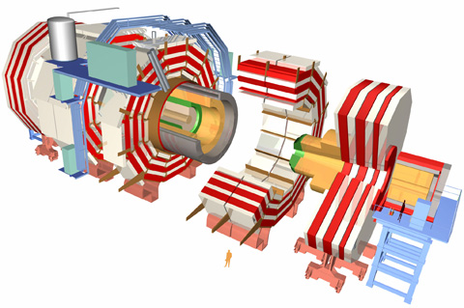
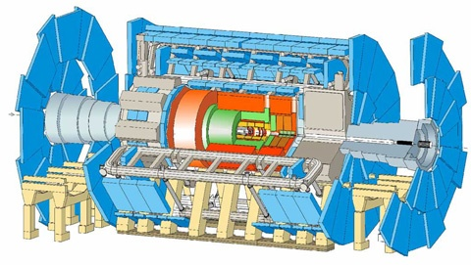
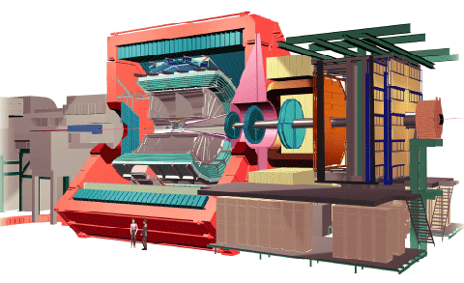
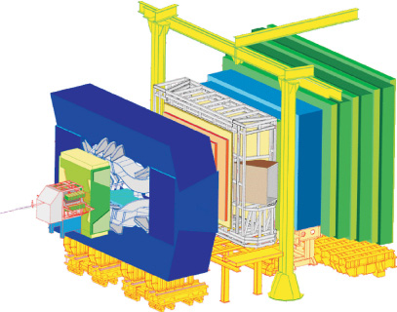
CERN Experiments
Huge, general purpose experiments:
“Medium” special purpose experiments:
Compact Muon Solenoid (CMS)
A Toroidal LHC ApparatuS (ATLAS)
A Large Ion Collider Experiment (ALICE)
B physics at the LHC (LHCb)

Slide 46
Plan for Next Decade
Run until end of 2011, or until 1 fb⁻¹ of integrated luminosity
About 5% of the way there, so far
Shut down for ~15 month to fully repair all ~10000 faulty joints
Resolder
Install clamps
Install pressure relief on all cryostats
Shut down in 2016
Tie in new LINAC
Increase Booster energy 1.4->2.0 GeV
Finalize collimation system (LHC collimation is a talk in itself)
Shut down in 2020
Full luminosity: >5x10³⁴ leveled
New inner triplets based on Nb₃Sn
Crab cavities
Large Pewinski Angle being pursued as backup

